Slide 1
Lecture 1.30
Structure of the optimal receiver deterministic signals.
Receiver Design:
  Demodulation
    Matched Filter
    Correlator Receiver
  Detection
    Max. Likelihood Detector
      Probability of Error

Slide 2
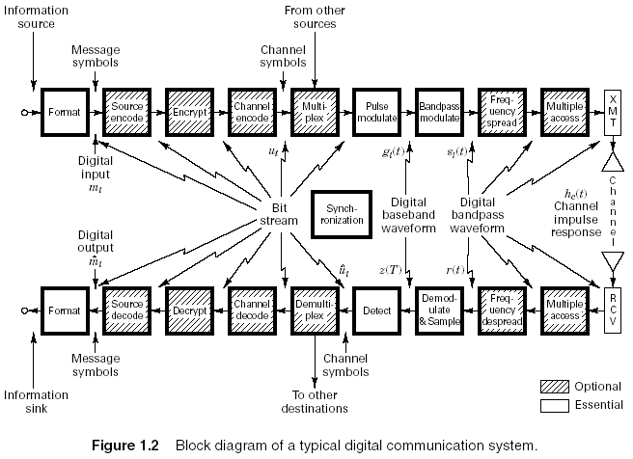
Transmit and Receive Formatting

Slide 3
Sources of Error in received Signal
Major sources of errors:
  Thermal noise (AWGN)
    disturbs the signal in an additive fashion (Additive)
    has flat spectral density for all frequencies of interest (White)
    is modeled by Gaussian random process (Gaussian Noise)
  Inter-Symbol Interference (ISI)
    Due to the filtering effect of transmitter, channel and receiver, symbols are “smeared”.

Slide 4
Receiver Structure
Demodulation/Detection of digital signals

Slide 5
Receiver Structure (contd)
The digital receiver performs two basic functions:
  Demodulation
  Detection
Why demodulate a baseband signal???
  Channel and the transmitter’s filter causes ISI which “smears” the transmitted pulses
  Required to recover a waveform to be sampled at t = nT.
Detection
  decision-making process of selecting possible digital symbol

Slide 6
Important Observation
Detection process for bandpass signals is similar to that of baseband signals. WHY???
Received signal for bandpass signals is converted to baseband before detecting
  Bandpass signals are heterodyned to baseband signals
  Heterodyning refers to the process of frequency conversion or mixing that yields a spectral shift in frequency.
For linear system mathematics for detection remains same even with the shift in frequency

Slide 7
Steps in designing the receiver
Find optimum solution for receiver design with the following goals:
  Maximize SNR
  Minimize ISI
Steps in design:
  Model the received signal
  Find separate solutions for each of the goals.

Slide 8
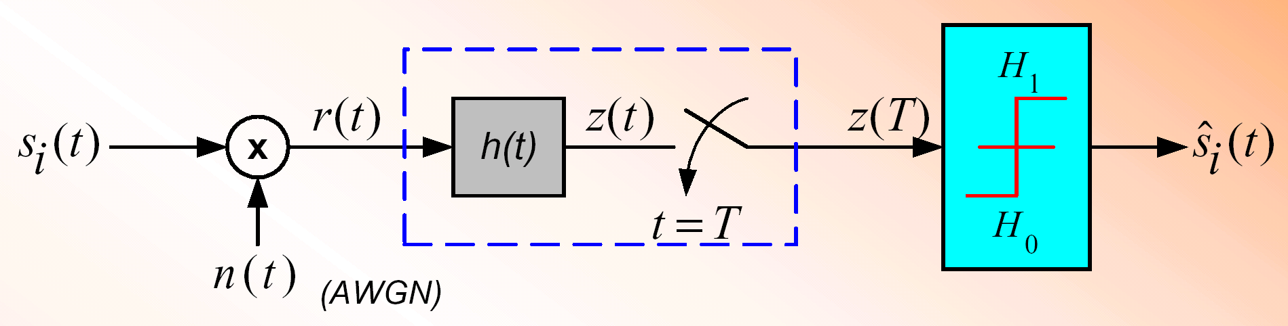
Detection of Binary Signal in Gaussian Noise
The recovery of signal at the receiver consist of two parts
  Filter
    Reduces the received signal to a single variable z(T)
    z(T) is called the test statistics
  Detector (or decision circuit)
    Compares the z(T) to some threshold level γ₀ , i.e.,
where H₁ and H₀ are the two possible binary hypothesis

Slide 9
Receiver Functionality
The recovery of signal at the receiver consist of two parts:
Waveform-to-sample transformation
    Demodulator followed by a sampler
    At the end of each symbol duration T, pre-detection point yields a sample z(T), called test statistic
  Where a_{i}(T) is the desired signal component,
  and n_{o}(T) is the noise component
Detection of symbol
    Assume that input noise is a Gaussian random process and receiving filter is linear

Slide 10
Finding optimized filter for AWGN channel
Assuming Channel with response equal to impulse function

Slide 11
Detection of Binary Signal in Gaussian Noise
For any binary channel, the transmitted signal over a symbol interval (0,T) is:
The received signal r(t) degraded by noise n(t) and possibly degraded by the impulse response of the channel h_{c}(t), is
Where n(t) is assumed to be zero mean AWGN process
For ideal distortionless channel where h_{c}(t) is an impulse function and convolution with h_{c}(t) produces no degradation, r(t) can be represented as:

Slide 12
Design the receiver filter to maximize the SNR
Model the received signal
Simplify the model:
  Received signal in AWGN
AWGN
Ideal channels
AWGN

Slide 13
Find Filter Transfer Function H₀(f)
Objective: To maximizes (S/N)_{T} and find h(t)
Expressing signal a_{i}(t) at filter output in terms of filter transfer function H(f)
where H(f) is the filter transfer funtion and S(f) is the Fourier transform of input signal s(t)
If the two sided PSD of i/p noise is N₀/2
Output noise power can be expressed as:
Expressing (S/N)_{T} :

Slide 14
For H(f) = H_{opt} (f) to maximize (S/N)_{T} use Schwarz’s Inequality:
Equality holds if f₁(x) = k f*₂(x) where k is arbitrary constant and * indicates complex conjugate
Associate H(f) with f₁(x) and S(f) e^{j2π fT} with f₂(x) to get:
Substitute yields to:

Slide 15
Or and energy E of the input signal s(t):
Thus (S/N)_{T} depends on input signal energy
and power spectral density of noise and
NOT on the particular shape of the waveform
Equality for holds for optimum filter transfer function H₀(f)
such that:
For real valued s(t):

Slide 16
MATCHED FILTER
The impulse response of a filter producing maximum output signal-to-noise ratio is the mirror image of message signal s(t), delayed by symbol time duration T.
The filter designed is called a MATCHED FILTER
Defined as:
a linear filter designed to provide the maximum
signal-to-noise power ratio at its output for a given
transmitted symbol waveform

Slide 17
Matched Filter Output of a rectangular Pulse

Slide 18
Replacing Matched filter with Integrator

Slide 19
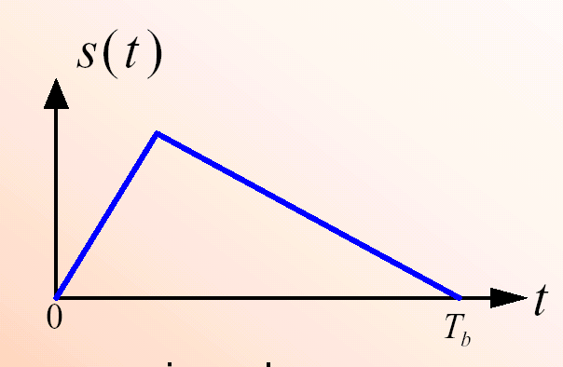
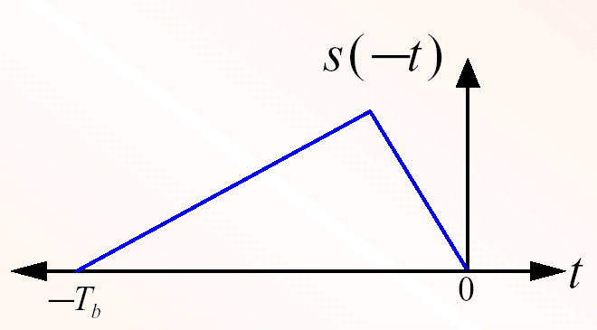
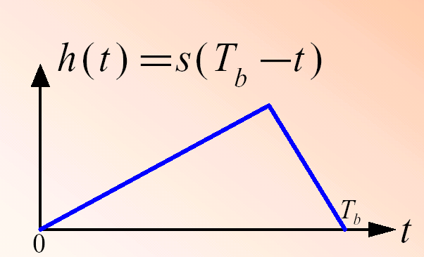
Correlation realization of Matched filter
A filter that is matched to the waveform s(t), has an impulse response
  h(t) is a delayed version of the mirror image (rotated on the t = 0 axis) of the original signal waveform
Mirror image of signal waveform
Impulse response of matched filter
Signal Waveform

Slide 20
Correlator Receiver
This is a causal system
  a system is causal if before an excitation is applied at time t = T, the response is zero for - ∝ < t < T
The signal waveform at the output of the matched filter is
Substituting h(t) to yield:
When t=T
So the product integration of rxd signal with replica of transmitted waveform s(t) over one symbol interval is called Correlation

Slide 21
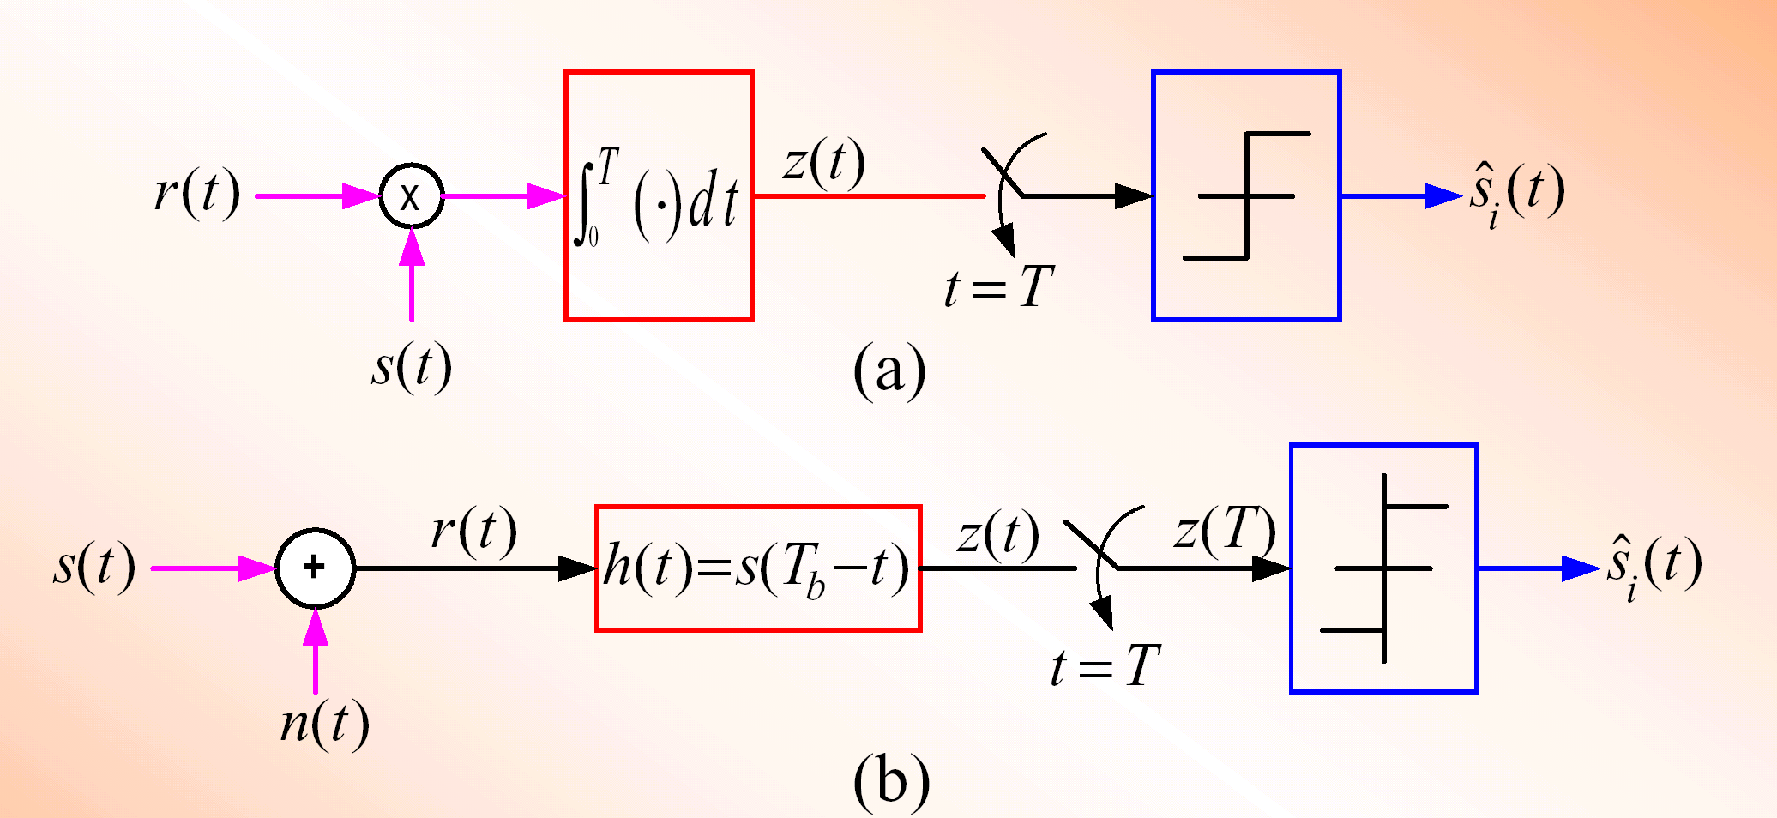
Correlator versus Matched Filter
The functions of the correlator and matched filter
The mathematical operation of Correlator is correlation, where a signal is correlated with its replica
Whereas the operation of Matched filter is Convolution, where signal is convolved with filter impulse response
But the o/p of both is same at t=T so the functions of correlator and matched filter is same.
Correlator
Matched Filter

Slide 22
Implementation of matched filter receiver
Bank of M matched filters
Matched filter output:
Observation
vector

Slide 23
Implementation of correlator receiver
Bank of M correlators
Correlators output:
Observation
vector

Slide 24
Example of implementation of matched filter receivers
Bank of 2 matched filters
0
T
t
0
T
0
T
0
T
t

Slide 25
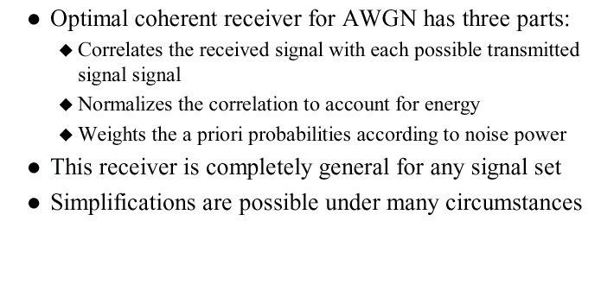
Key Facts

