Slide 1
Lecture 1.26 Spectral analysis of periodic and non-periodic signals.

Slide 2
How to Represent Signals?
Option 1: Taylor series represents any function using polynomials.
Polynomials are not the best - unstable and not very physically meaningful.
Easier to talk about “signals” in terms of its “frequencies”
(how fast/often signals change, etc).

Slide 3
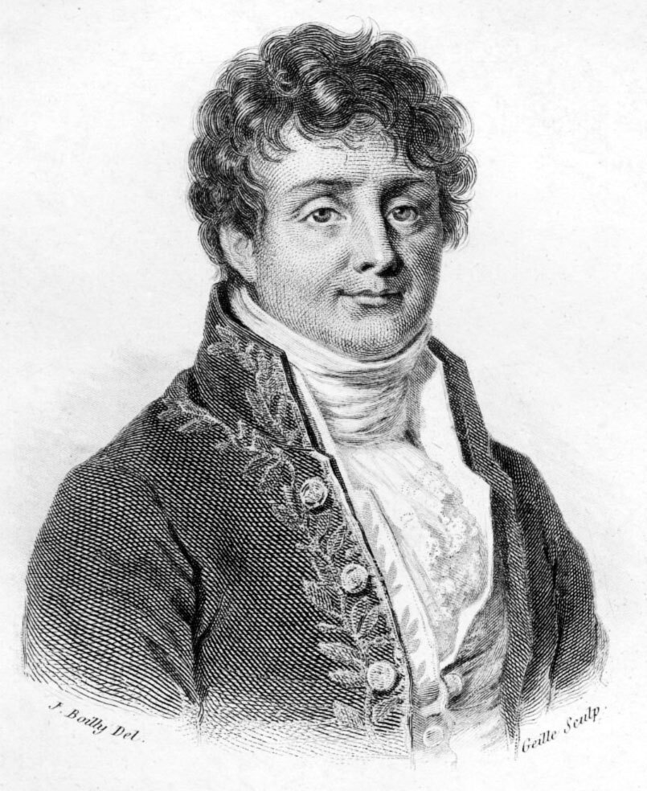
Jean Baptiste Joseph Fourier (1768-1830)
Had crazy idea (1807):
Any periodic function can be rewritten as a weighted sum of Sines and Cosines of different frequencies.
Don’t believe it?
Neither did Lagrange, Laplace, Poisson and other big wigs
Not translated into English until 1878!
But it’s true!
called Fourier Series
Possibly the greatest tool
used in Engineering

Slide 4
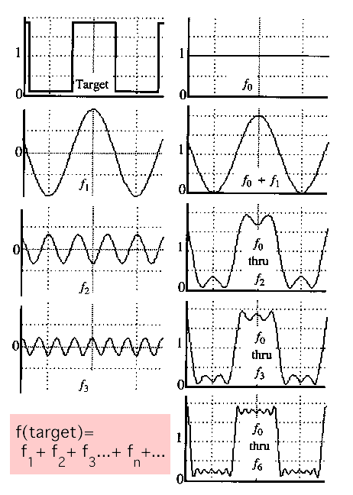
A Sum of Sinusoids
Our building block:
Add enough of them to get any signal f(x) you want!
How many degrees of freedom?
What does each control?
Which one encodes the coarse vs. fine structure of the signal?

Slide 5
Fourier Transform
We want to understand the frequency ω of our signal. So, let’s reparametrize the signal by ω instead of x:
f(x)
Fourier
Transform
F(ω)
For every ω from 0 to inf, F(ω) holds the amplitude A and phase φ of the corresponding sine
How can F hold both? Complex number trick!
F(ω)
Inverse Fourier
Transform
f(x)

Slide 6
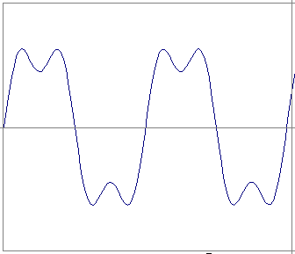
Time and Frequency
example : g(t) = sin(2pi f t) + (1/3)sin(2pi (3f) t)

Slide 7
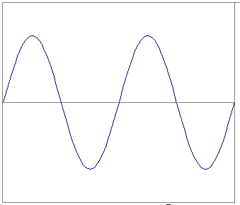
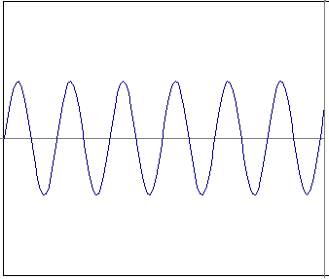
Time and Frequency
example : g(t) = sin(2pi f t) + (1/3)sin(2pi (3f) t)
=
+

Slide 8
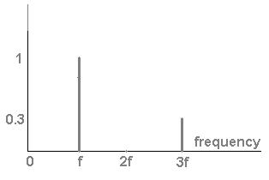
Frequency Spectra
example : g(t) = sin(2pi f t) + (1/3)sin(2pi (3f) t)
=
+

Slide 9
Frequency Spectra
Usually, frequency is more interesting than the phase

Slide 10
Frequency Spectra
=
+
=

Slide 11
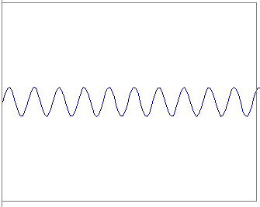
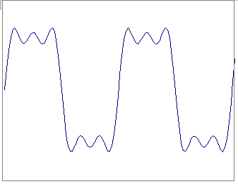
Frequency Spectra
=
+
=

Slide 12
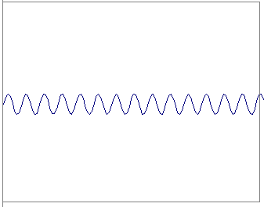
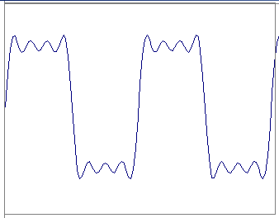
Frequency Spectra
=
+
=

Slide 13
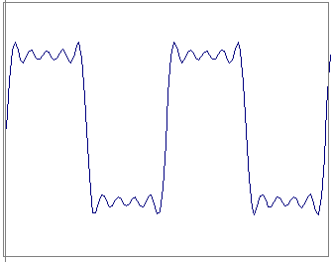
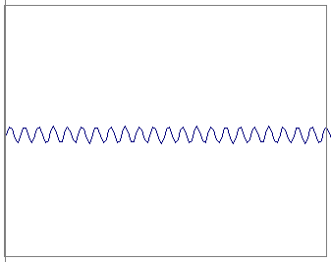
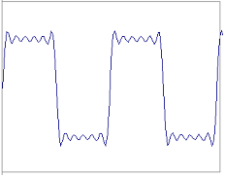
Frequency Spectra
=
+
=

Slide 14
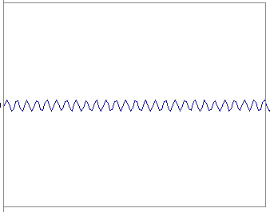
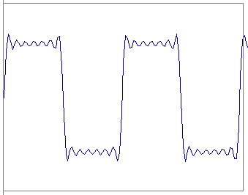
Frequency Spectra
=
+
=

Slide 15
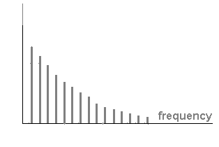
Frequency Spectra
=

Slide 16
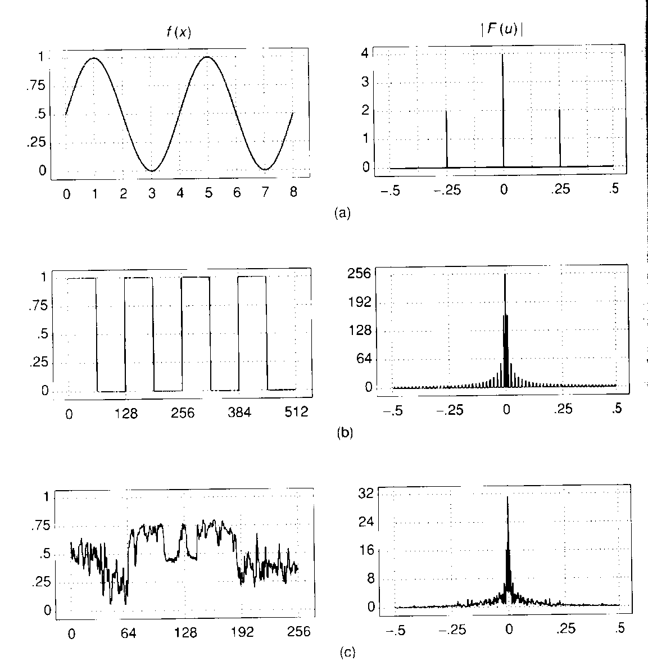
Frequency Spectra

Slide 17
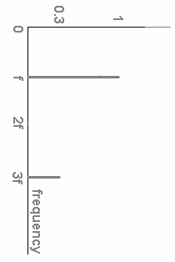
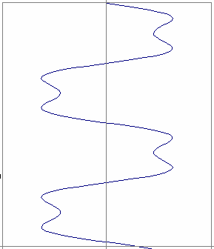
FT: Just a change of basis
M * f(x) = F(ω)
*
=
.
.
.

Slide 18
IFT: Just a change of basis
M⁻¹ * F(ω) = f(x)
*
=
.
.
.

Slide 19
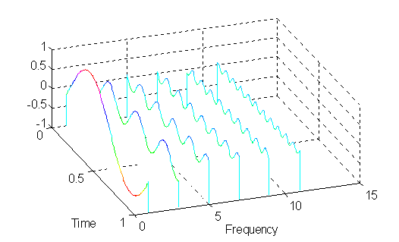
FT: Just a change of basis
*
=

Slide 20
Fourier Transform – more formally
Represent the signal as an infinite weighted sum
of an infinite number of sinusoids
Note:
Arbitrary function
Single Analytic Expression
Spatial Domain (x)
Frequency Domain (u)
(Frequency Spectrum F(u))
Inverse Fourier Transform (IFT)

Slide 21
Fourier Transform
Also, defined as:
Note:
Inverse Fourier Transform (IFT)

Slide 22
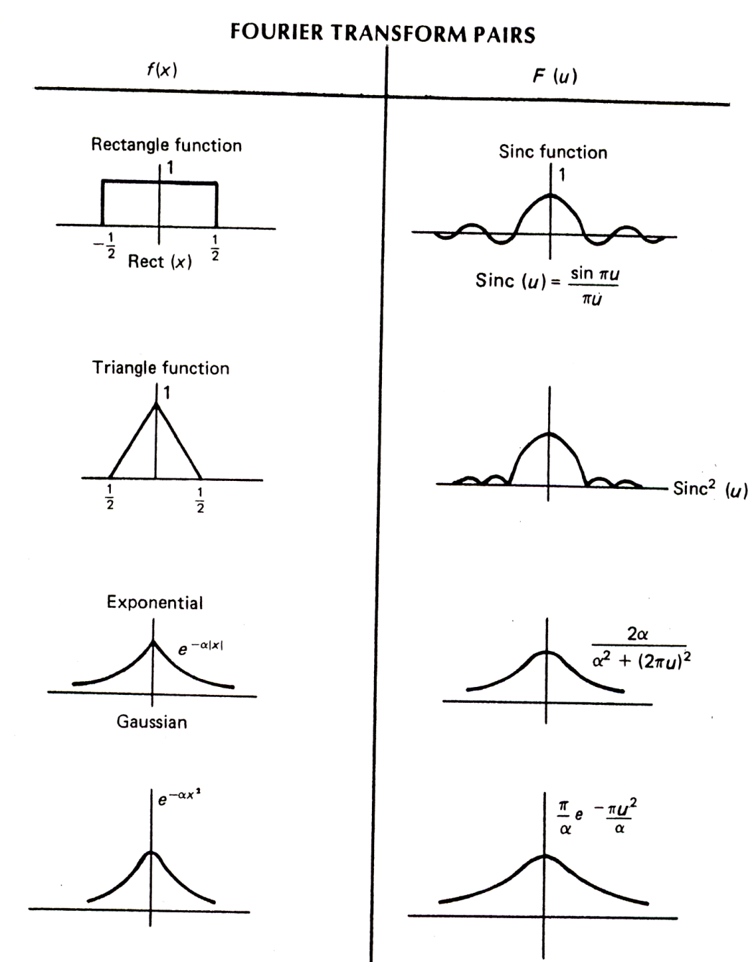
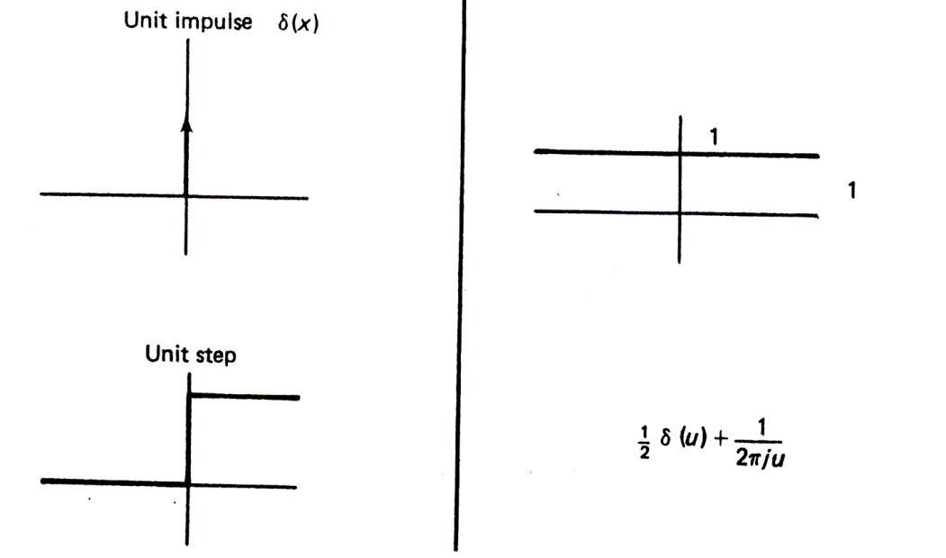
Fourier Transform Pairs (I)
Note that these are derived using
angular frequency ( )

Slide 23
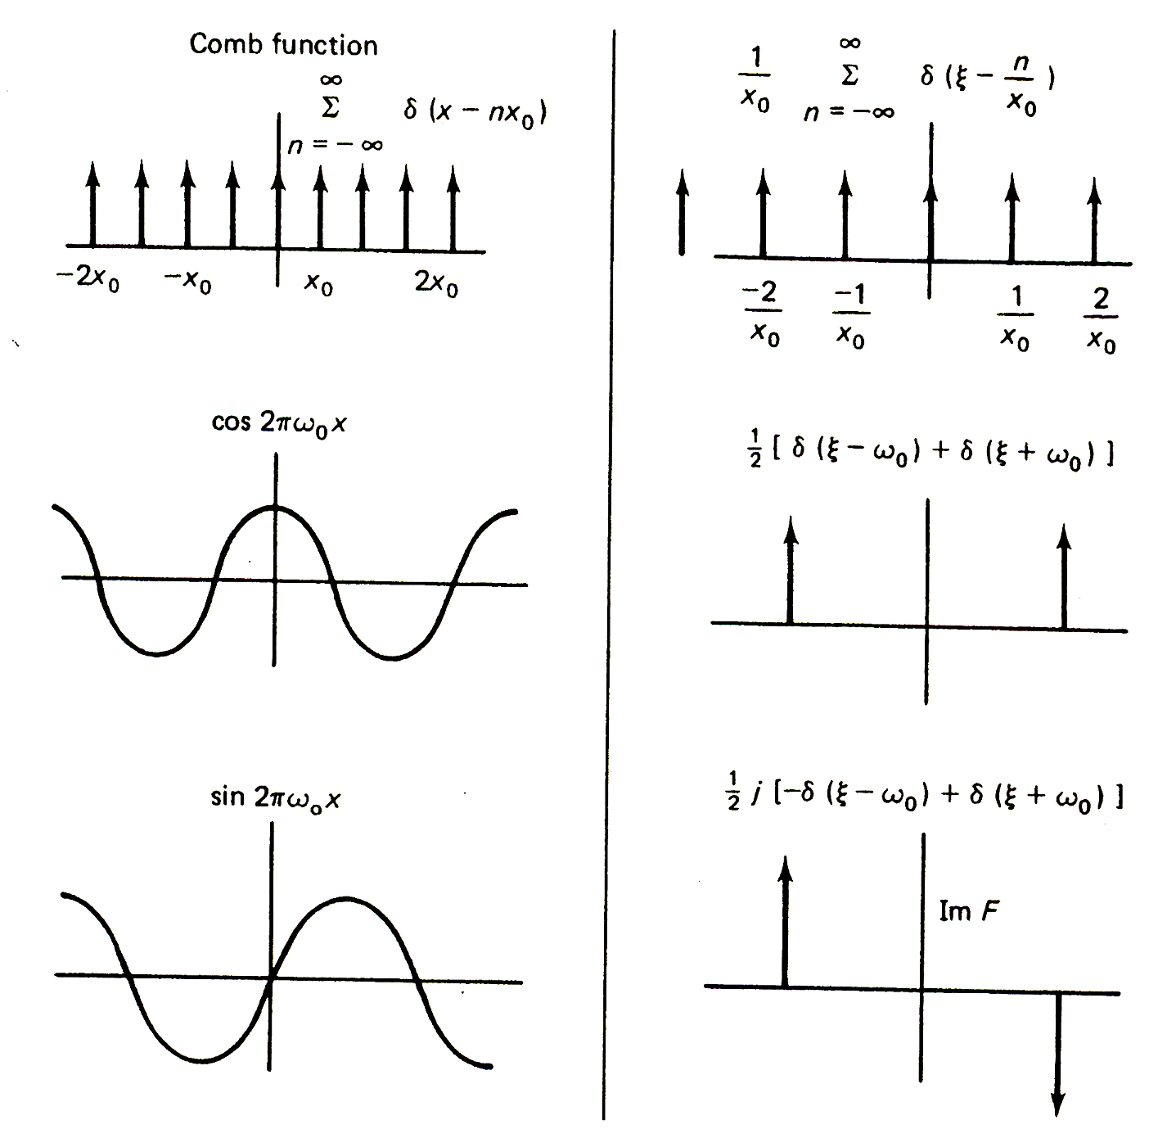
Fourier Transform Pairs (I I)
Note that these are derived using
angular frequency ( )

Slide 24
Fourier Transform and Convolution
Let
Then
Convolution in spatial domain
Multiplication in frequency domain

Slide 25
Fourier Transform and Convolution
Spatial Domain (x)
Frequency Domain (u)
So, we can find g(x) by Fourier transform
IFT
FT
FT

Slide 26
Properties of Fourier Transform
Spatial Domain (x)
Frequency Domain (u)
Linearity
Scaling
Shifting
Symmetry
Conjugation
Convolution
Differentiation
Note that these are derived using
frequency ( )

Slide 27
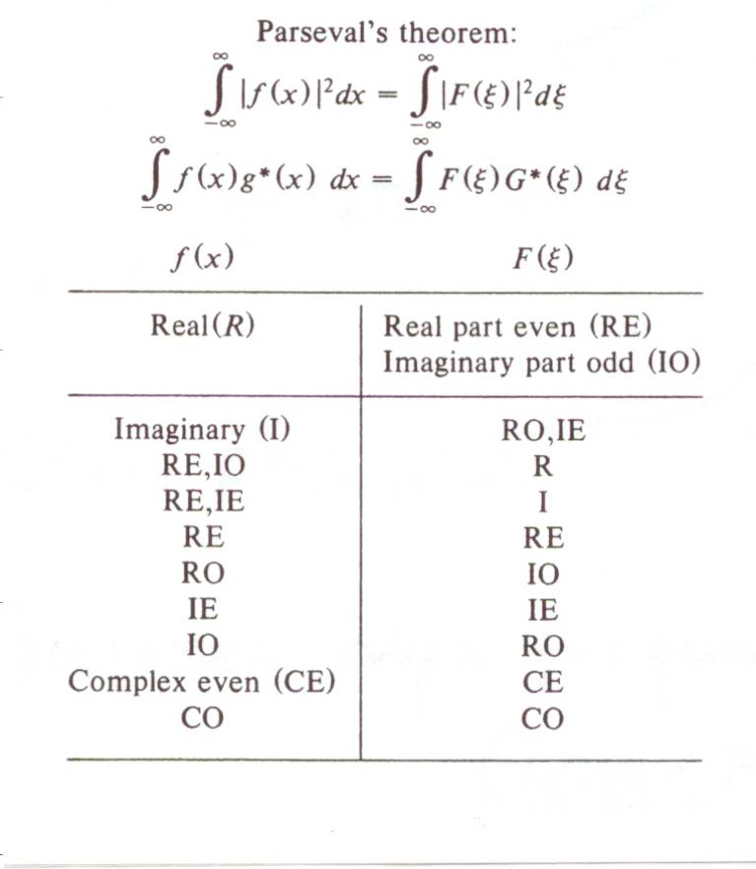
Properties of Fourier Transform

