Slide 1
Lecture 1.25 Deterministic and random radio signals. The signals and messages.

Slide 2
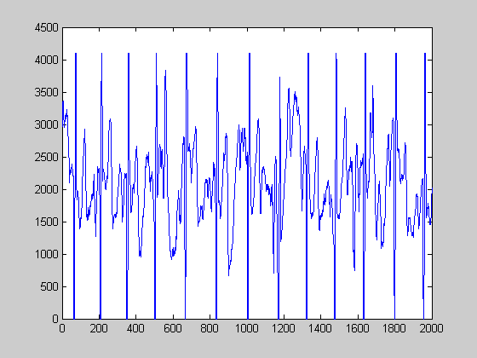
Signal examples
Electrical signals --- voltages and currents in a circuit
Acoustic signals --- audio or speech signals (analog or digital)
Video signals --- intensity variations in an image (e.g. a CAT scan)
Noise: unwanted signal

Slide 3
Classification of Signals
Deterministic and random signals
Deterministic signal : No uncertainty with respect
to the signal value at any time
Random signal : Some degree of uncertainty in
signal values before it actually occurs
Thermal noise in electronic circuits due to the random
movement of electrons
Reflection of radio waves from different layers of ionosphere

Slide 4
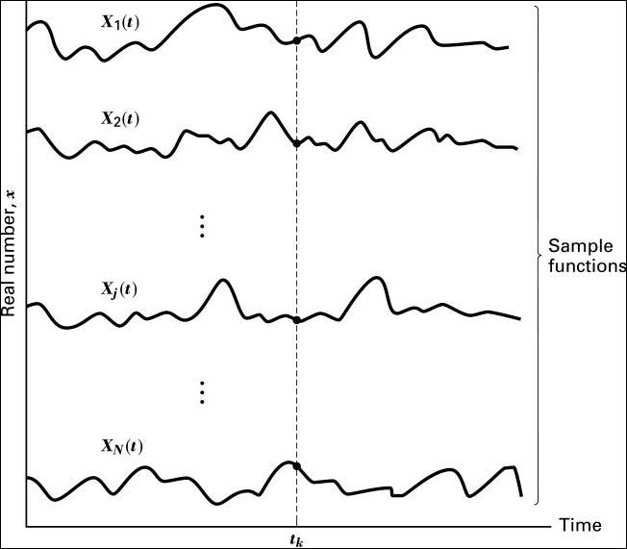
Random Process
A random process is a collection of time function, or signals, corresponding to various outcomes of random experiment. For each outcome, , there exists a deterministic function, which is called a sample function or a realization

Slide 5
Random Process (cont´d)
Strictly stationary : If none of the statistics of the random process are affected by a shift in the time origin
Wide sense stationary (WSS): If the mean and autocorrelation function do not change with a shift in the time origin
Cyclostationary : If the mean and autocorrelation are periodic in time with some period

Slide 6
Random Process (cont´d)
Ergodic process : A random process is ergodic in mean and autocorrelation, if

Slide 7
Periodic and non-periodic signals
Periodic signals have the property that x(t + T) = x(t) for all t.
The smallest value of T that satisfies the definition is called the period.
Shown below are an non-periodic signal (left) and a periodic signal (right).

Slide 8
Analog Signals
A signal whose amplitude can take on any value in a continuous range is an analog signal.
Human Voice – best example
Ear recognises sounds 20KHz or less
AM Radio – 535KHz to 1605KHz
FM Radio – 88MHz to 108MHz

Slide 9
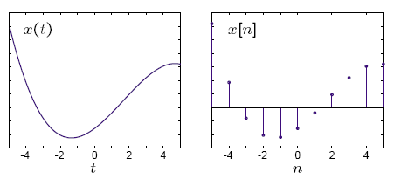
Continuous time (CT) and discrete time (DT) signals
CT signals take on real or complex values as a function of an independent variable that ranges over the real numbers and are denoted as x(t).
DT signals take on real or complex values as a function of an independent variable that ranges over the integers and are denoted as x[n].
Note the subtle use of parentheses and square brackets to distinguish between CT and DT signals.

Slide 10
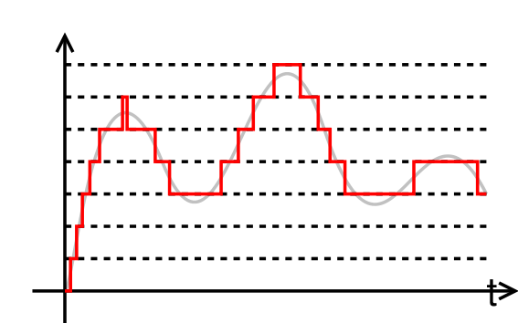
Quantization
From amplitude domain
N bit quantization, L intervals L=2^{N}
Usually 8 to 16 bits
Error Performance: Signal to noise ratio

Slide 11
Digital signals
Represented by Square Wave
All data represented by binary values
Single B inary Digit – Bit
Transmission of contiguous group of bits is a bit stream
Not all decimal values can be represented by binary

Slide 12
Analogue vs. Digital
Analogue Advantages
Best suited for audio and video
Consume less bandwidth
Available world wide
Less susceptible to noise
Digital Advantages
Best for computer data
Can be easily compressed
Can be encrypted
Equipment is more common and less expensive
Can provide better clarity

Slide 13
Analog or Digital
Analog Message: continuous in amplitude and over time
AM, FM for voice sound
Traditional TV for analog video
First generation cellular phone (analog mode)
Record player
Digital message: 0 or 1, or discrete value
VCD, DVD
2G/3G cellular phone
Data on your disk
Your grade
Digital age: why digital communication will prevail

Slide 14
Digital and Analog Messages
Messages could be digital or Analog
Digital Message: Ordered combinations of finite symbols or codewords.
Which of the following is digital: text document in English constructed from ASCII keyboard, human speech, music notes, music sound, morse code is digital (dash and dot),
A digital message constructed with M symbols is called M –ary message.
Analog Messages: Characterized by data whose values vary over a continuous range of time e.g. temperature, atmospheric Pressure, speech waveform,

Slide 15
Digital and Analog Messages (contd)
Why are digital technologies better and Why are they replacing the analog technologies? Enhanced Immunity to noise and interference and microprocessor (powerful, high speed and inexpensive)
Message extraction from received signal is easier for digital signal since digital decision must belong to the finite-sized alphabet. Detail of received signal is not an issue
Digital communication system is more rugged than analog because it can better withstand noise and distortion( as long as they are within limit)

Slide 16
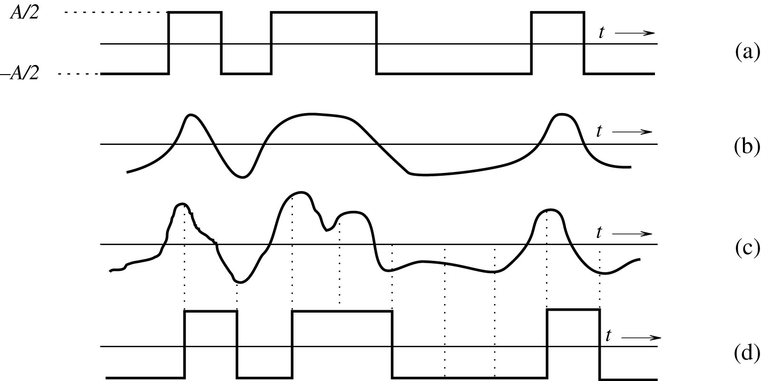
Regeneration digital signal
(a) Transmitted signal. (b) Received distorted signal (without noise).
(c) Received distorted signal (with noise). (d) Regenerated signal (delayed).

Slide 17
Analog-to-Digital (A/D) Conversion
Analog signal – continuous in time and range
Digital signal – exist at discrete points in time and can take on only finite values
ADC can never be 100% accurate.
Two steps in A/D conversion – sampling and quantization
Continuous time signal is sampled into discrete time signal (DTS)
Continuous amplitude of the DTS is quantized into discrete level signal
Frequency Spectrum : specifies the relative magnitude of various frequency component of a signal
Sampling Theorem: if the highest frequency in signal spectrum is B (in Hz), the signal can be reconstructed from its discrete samples taken uniformly at a rate not less than 2B samples per second.
We need only to transmit signal sample to preserve its information

Slide 18
Analog-to-Digital (A/D) Conversion
Sampled Signal lie in a continuous range – quantization
Quantization: Sample is approximated or “rounded off” to the nearest quantized level.
Given signal m(t), whose amplitude range (–mp, mp), quantizer partitions the signal range into L intervals. Each sample amplitude ~ midpoint of interval.
Each sample is represented by one of the L numbers (digitized).
Quantized signal is an approximation of original signal.
Accuracy improves with increase in L
Voice signal L = 8 or 16 is sufficient.
Commercial – L = 32 is minimum, telephone- L 128 or 256
Notes:
~ -approximately

Slide 19
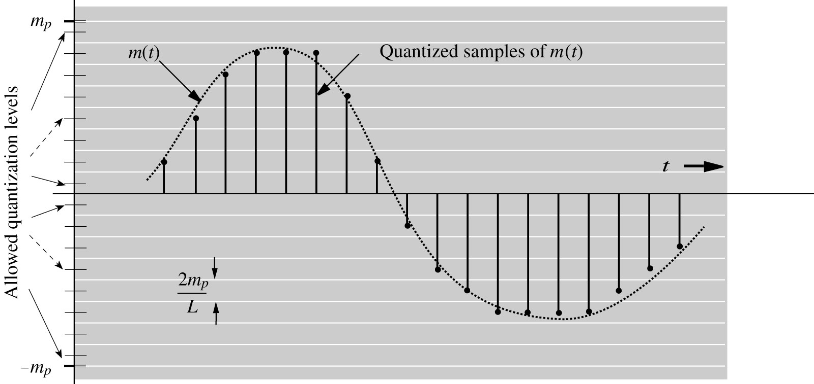
Analog-to-digital conversion of a signal.

Slide 20
Pulse-Coded Modulation
The task of Communication system is to transmit the quantized samples
Signal waveforms are used to represent the quantized sample sequence in the transmission process (done with the aid of PCM)
One information bit refers to one binary digit 1 or 0.
In PCM, each quantized sample is represented by an ordered combination of pulses p1(t) and p2(t) where p₁(t) represents 1 and p₂(t) represents 0
Each of the L possible sample can be written as a bit string of length log₂L
Each pulse can be mapped into a binary sequence of bits
In PCM, signaling is carried out with two basic pulses

Slide 21
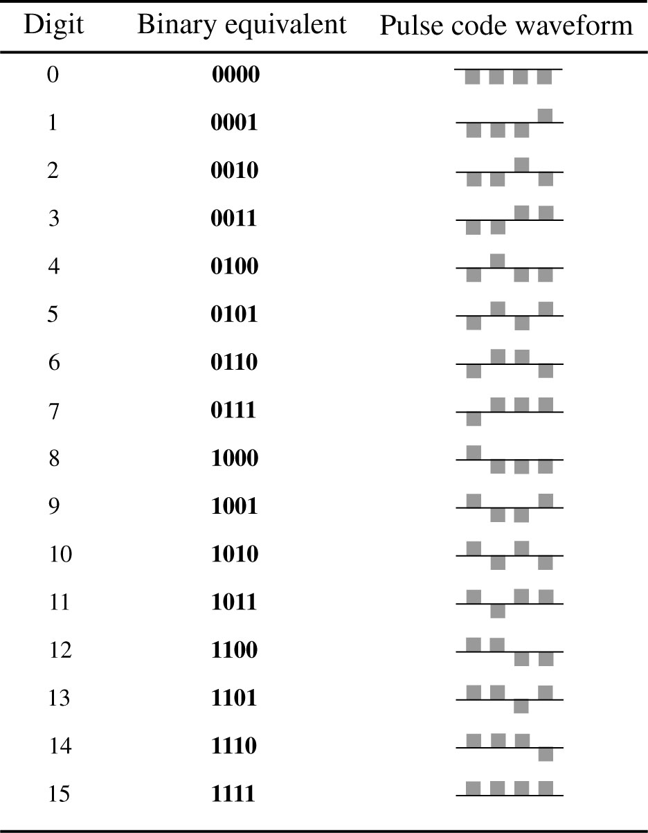
Example of PCM encoding

Slide 22
Signal-To-Noise Ratio and Capacity
Primary communication resources – bandwidth and signal power
Channel bandwidth B and signal power control the rate and quality
Bandwidth of a channel: range of frequencies that it can transmit with reasonable fidelity (signal also have bandwidth!)
A signal can be successfully sent over a channel if the channel bandwidth exceeds the signal bandwidth
The number of pulses per second that can be transmitted over a channel is directly proportional to its bandwidth B

Slide 23
Signal power
Signal power (Ps): affects quality of transmission. Increasing Ps strengthens the signal pulse and diminishes the effect of channel noise and interference
Quality of analog or digital communication systems vary with the signal-to-noise ratio (SNR)
There is a minimum SNR for successful communication
Larger Ps allows the system to maintain a min SNR over longer distance.
To maintain a given rate and accuracy of information transmission, Ps can be traded for bandwidth B and vice versa.
Ps can be increased to reduce bandwidth B or Ps is reduced to use bigger bandwidth B
Notes:
Telephone has limited bandwidth of 3 KHz but unlimited power
Space vehicle has huge bandwidth but limited power.

Slide 24
Noise in Communication System
Undesirable interferences and disturbances that corrupts signal passing through communication channel (different from channel distortion)
Random, and unpredictable.
External noise: Interference signals transmitted on nearby channels, human-made noise generated from faulty contact switches of electrical equipment, automobile ignition radiation, lightening, and cell phones emission.
Internal noise: results from thermal motion of charged particles in conductors, random emission, and diffusion or recombination of charged carriers in electronic devices
Noise limits the rate of telecommunications.

Slide 25
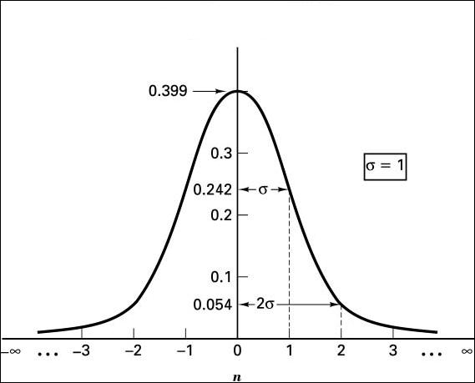
Additive White Guassian Noise (AWGN)
Thermal noise is described by a zero-mean Gaussian random process, n(t)
Its PSD is flat, hence, it is called white noise.
Probability density function

Slide 26
Channel Capacity and Data Rate
Channel bandwidth limits the bandwidth of signal passing through the channel
Signal SNR at the receiver determines the recoverability of the transmitted signal
Higher SNR means that the transmitted pulse can use more signal levels, and bits for each pulse transmission
The SNR and bandwidth affects the channel throughput
The peak throughput that can be reliably carried by a channel is called Channel capacity
Additive White Guassian Noise (AWGN) – most widely encountered channel. Assume no channel distortions except for white Guassian noise and its finite bandwidth

Slide 27
Shannon Theory
Shannon Theory
It establishes that given a noisy channel with information capacity C and information transmitted at a rate R, then if R<C, there exists a coding technique which allows the probability of error at the receiver to be made arbitrarily small. This means that theoretically it is possible to transmit information without error up to a limit C.
The converse is also important. If R>C, the probability of error at the receiver increases without bound as the rate is increased. So no useful information can be transmitted beyond the channel capacity. The theorem does not address the rare situation in which rate and capacity are equal.

Slide 28
Shannon Capacity (equation)
C = B log₂(1+ SNR)
If noise is zero, SNR = ∞ hence capacity will be infinity.
Any amount of information can be transmitted in the world over noiseless channel.
If noise were zero, there will be no uncertainty in the received pulse amplitude without error.

Slide 29
Channel capacity
C – Channel Capacity and is the upper bound on the rate of information transmission per second or is the maximum number of bits that can be transmitted per second with probability of error arbitrarily close to zero.
Equation does not tell us how this can be realized
Not possible to transmit at a rate higher than this without incurring any error.
Practical system operate at rates below the shannon rate.
B and SNR demonstrate ultimate limitation on the rate of communication.
Notes:
If noise is zero, SNR = ∞ hence capacity will be infinity. Any amount of information of information can be transmitted in the world over noiseless channel. If noise were zero, there will be no uncertainty in the received pulse amplitude without error.

Slide 30
Digital Source Coding and Error Correction Coding
SNR and bandwidth determine performance of communication system
Digital communications system often aggressively adopt measures to lower source data rate and fight channel noise
Source coding – generates the fewest bits possible for a given message without sacrificing its detection accuracy
Channel coding – introduces redundancy systematically at the transmitter to combat errors that arise from noise and interference

Slide 31
Randomness, Redundancy and Source Coding
Randomness is the essence of communication
A predictable message is not random and is fully redundant
A message contain information if it is unpredictable
Shorter codes are more efficient since they require less time to transmit at a given data rate
Source coding: More likely messages are assigned shorter codes and the less likely messages with longer code
Entropy or Source Coding: information of a message with probability P is proportional to log(1/p)
Error correction coding: Adding redundancy to a message in order to detect and correct error.
Notes:
In Morse Code - e, t, a are assigned to Shorter codes
X, q, z are assigned to longer codes
Even and Odd parity

